Slide 1
Data Wrangling on a Set of Datasets by Siddhesh Khairnar from digicrome academy

Slide 2
in this project i have done different types of data wrangling
Merging datasets
Identifying unique values
Dropping unnecessary columns
Checking the datatype of the datasets
Treating missing values
I have also done
graphical visualization
analyzing outliers
fixing outliers

Slide 3
some challenges i have experienced
dataset 1 and dataset 2 were easy
dataset 3 was a bit difficult
in dataset 3 there are some values that are upside down
so i made simple logic
like A=4,5,6,1,2,3 to make it in order
jut copy 4,5,6 and pest in last and delete 4,5,6 in front
i.e. 4,5,6,1,2,3---4,5,6,1,2,3,4,5,6----1,2,3,4,5,6
and converted that logic to code

Slide 4
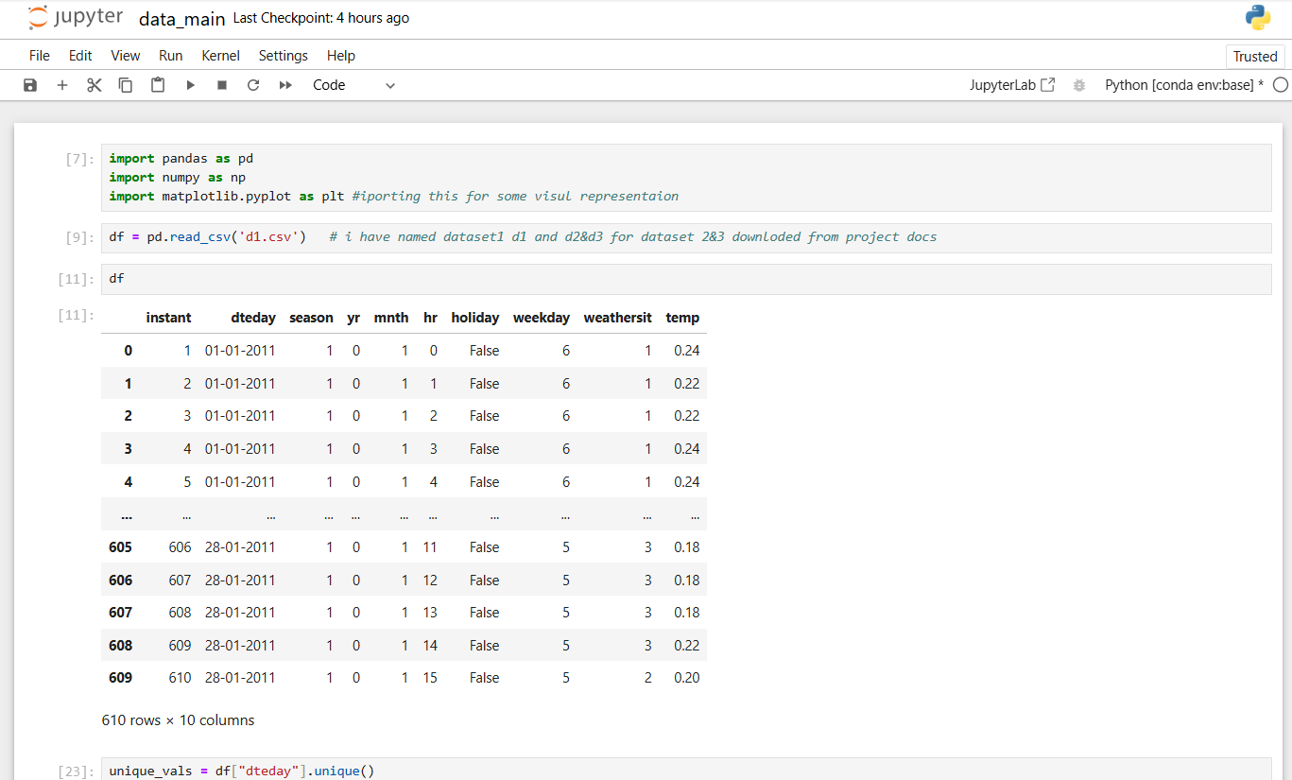
screenshots of first python script

Slide 5
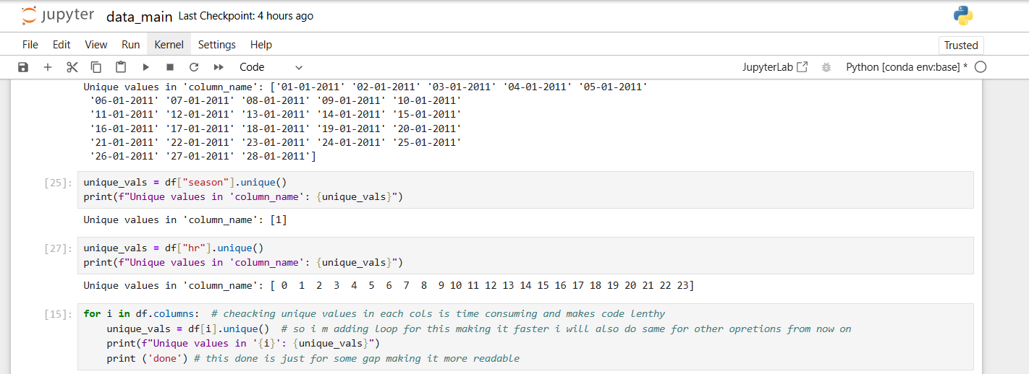
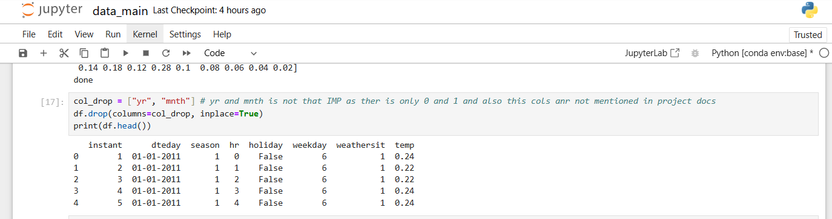

Slide 6
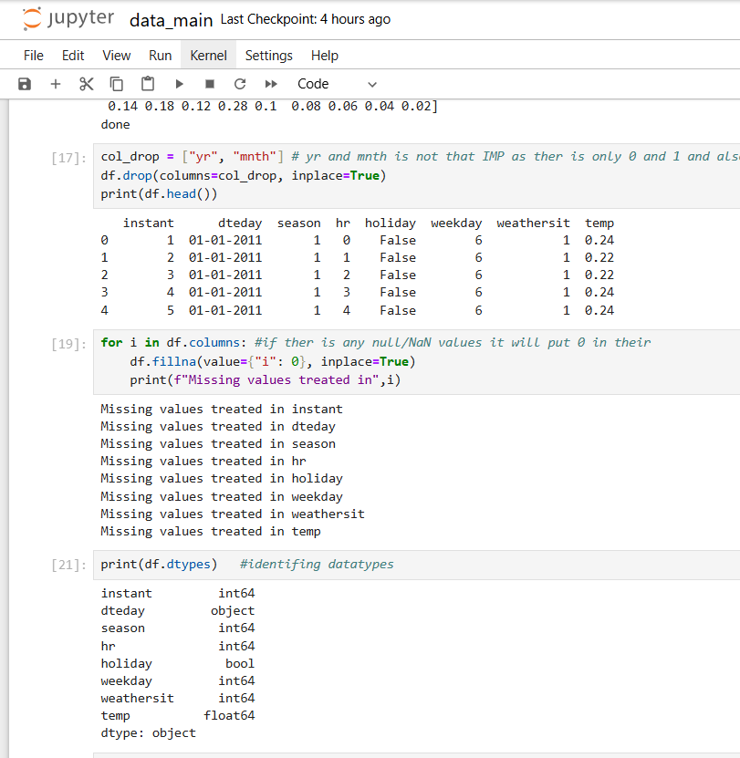
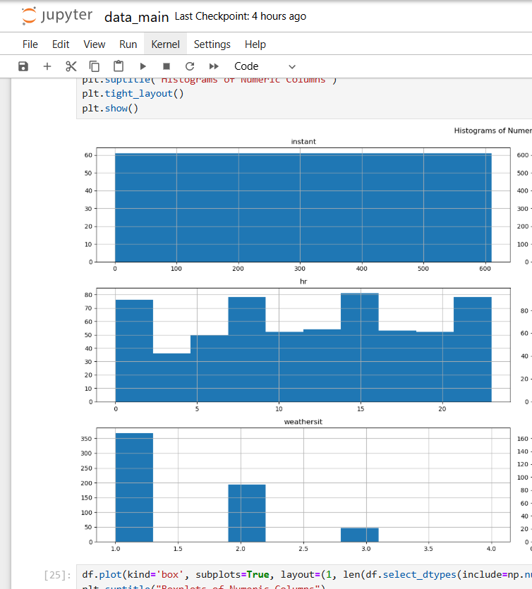

Slide 7
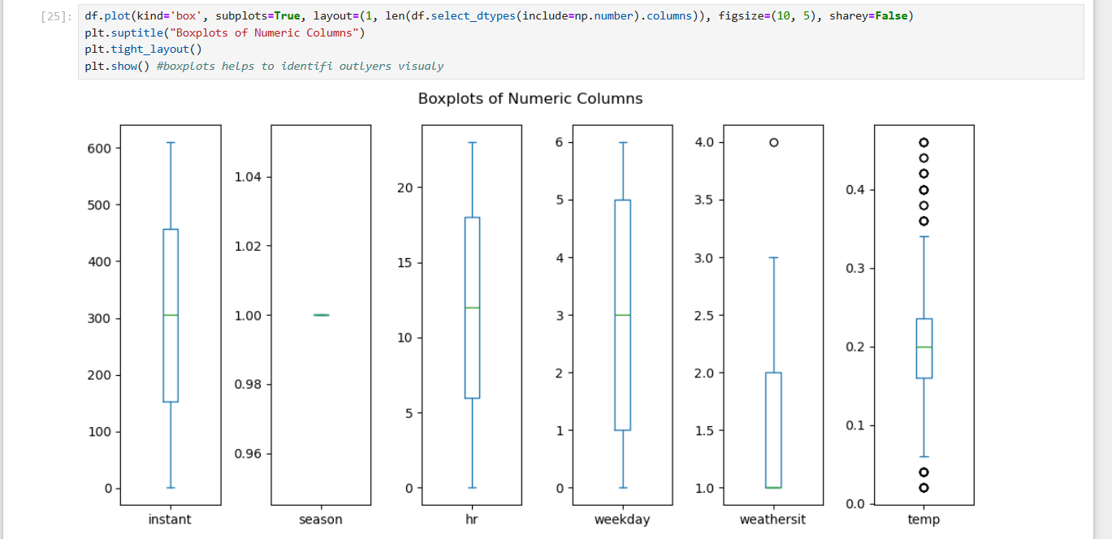

Slide 8
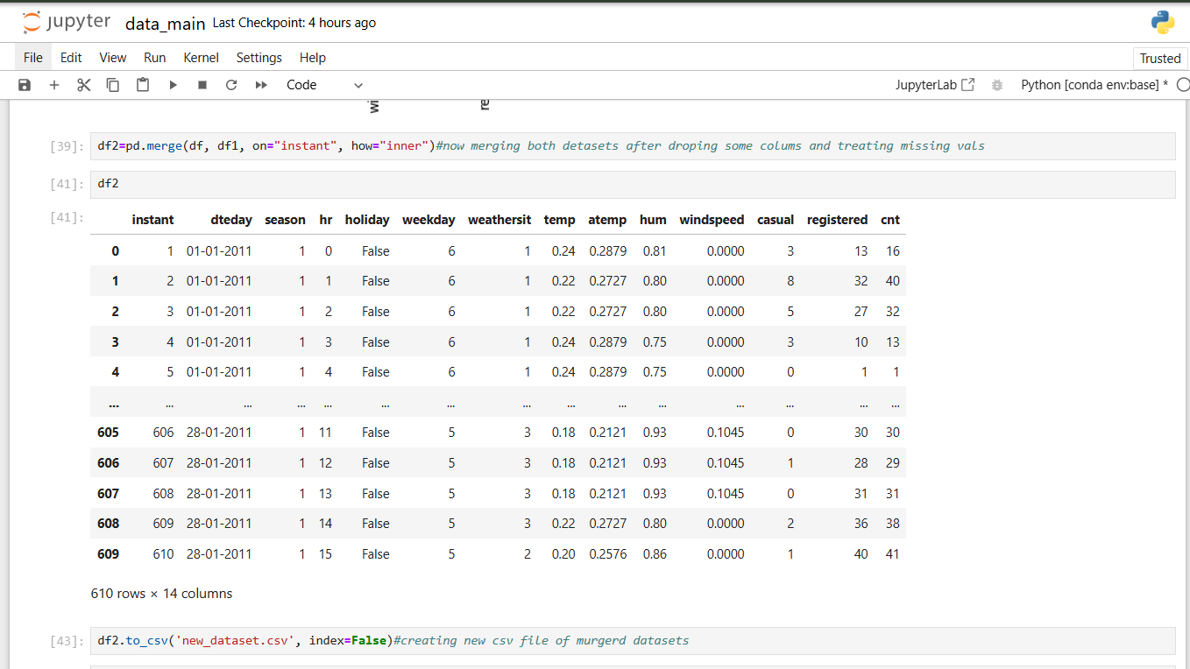

Slide 9
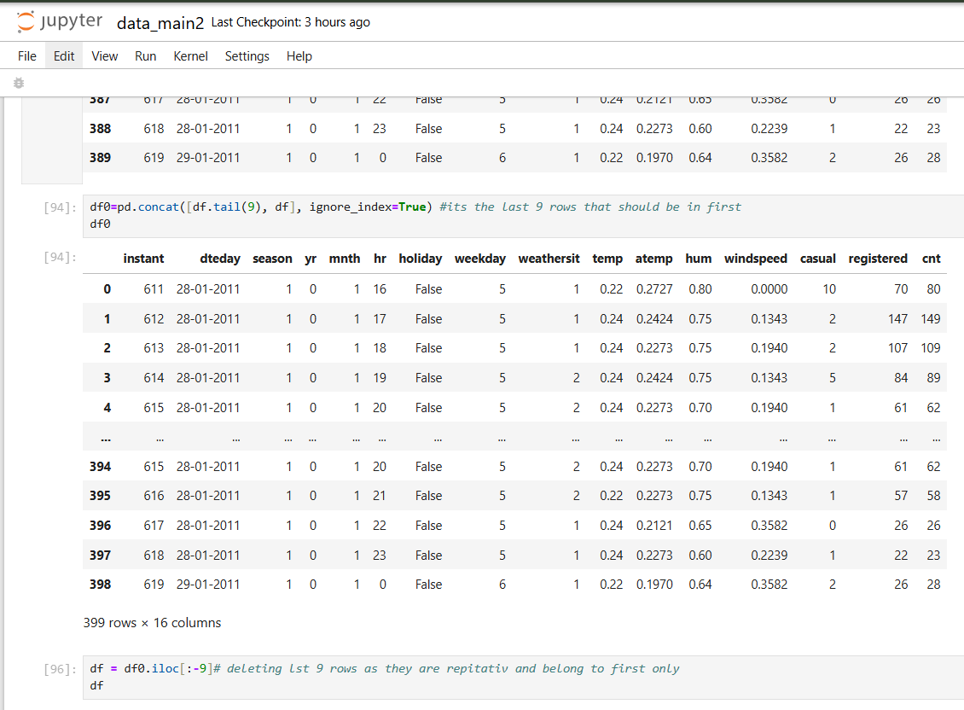
screenshots of second .py script

Slide 10
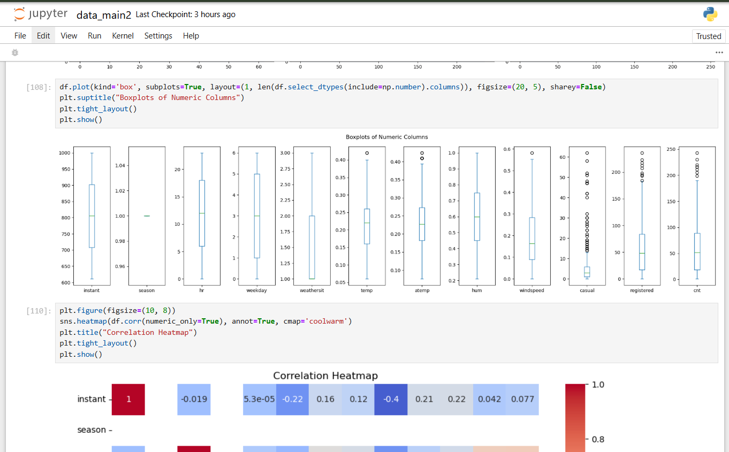

Slide 11
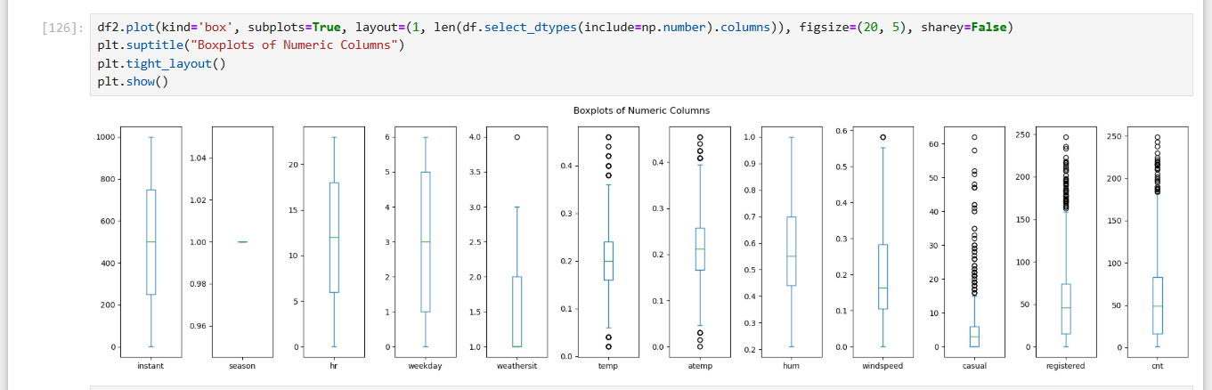
df2 is final dataset

Slide 12
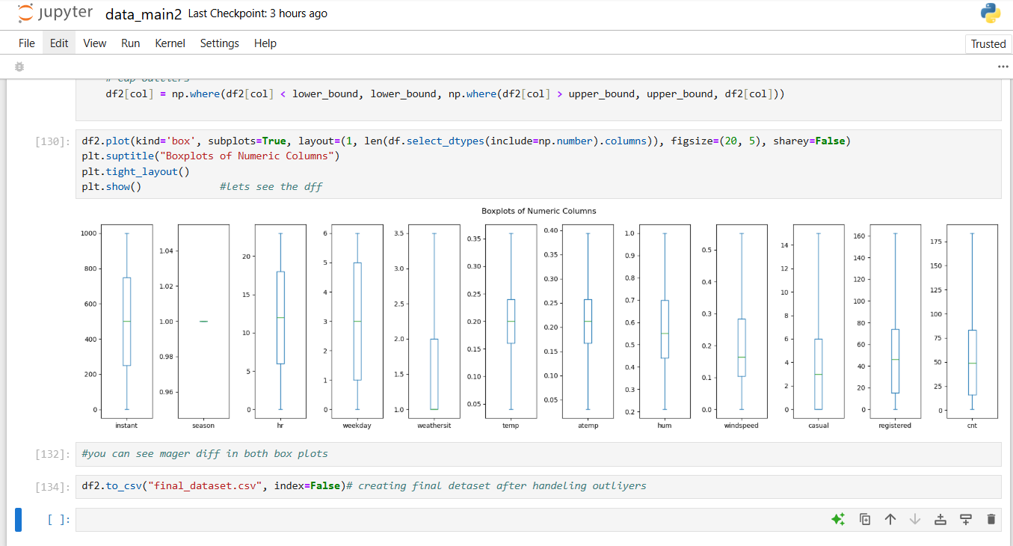
df2 after handling outliers

Slide 13
thank you for your attention hope my project meets your expectation

